Slide 1

DermaScan
DermaScan is a full stack web application empowering underprivileged kids with acne-related issues. Real-time acne analysis and personalized care to boost self-esteem and allow access to dermatological resources!
github.com/tiwariakshat47/DermaScan
Akshat Tiwari, Ashton Liu, Colin Henderson, Mateo Garcia

Slide 2
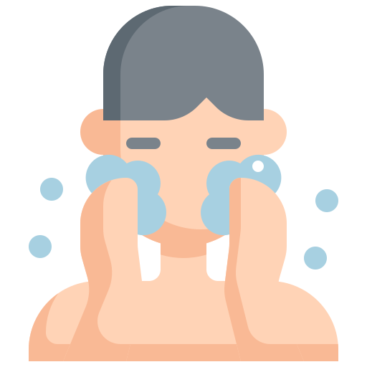
YOUR LOGO
HOME
ABOUT
SERVICE
CONTACT
PROBLEM
Acne affects 85% of the population, ages 12-24
Unable to access dermatological resources due to financial, geographical, or social barriers
Lack of knowledge or resources to manage common skin problems can lead to worsened outcomes

Slide 3
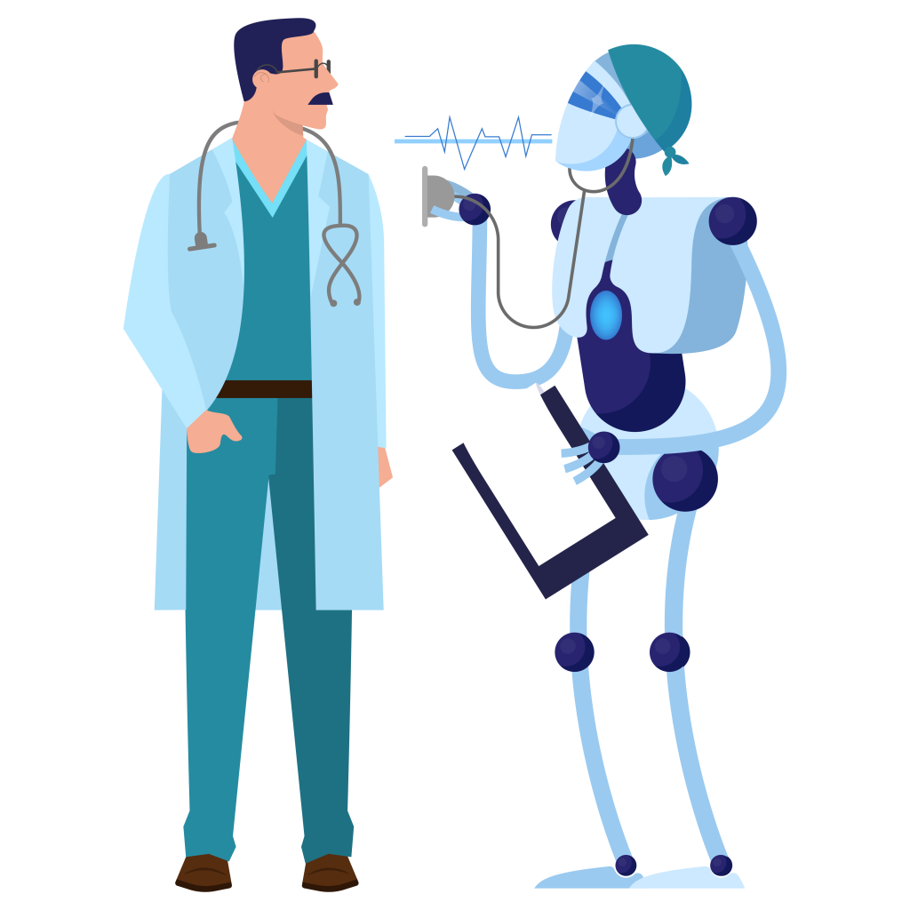
YOUR LOGO
HOME
ABOUT
SERVICE
CONTACT
SOLUTION
Innovative, full-stack solution that uses AI-powered image recognition to allow users to self-diagnose acne.
Either on smartphone or web app, receive instant, reliable feedback skin condition
Access personalized skincare routines and treatment recommendations
Offering educational resources in order to help understanding acne and managing different skin types
Furthers access to dermatological care but also promotes self-esteem, reduces the stigma surrounding acne, and empowers people to take control of their skin health

Slide 4
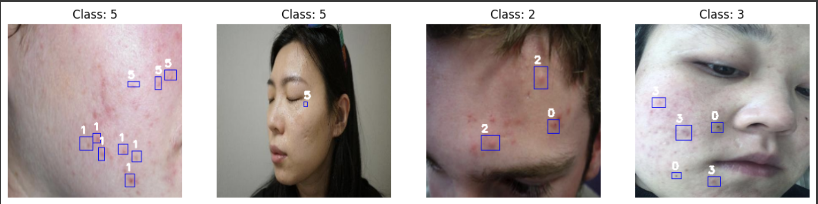
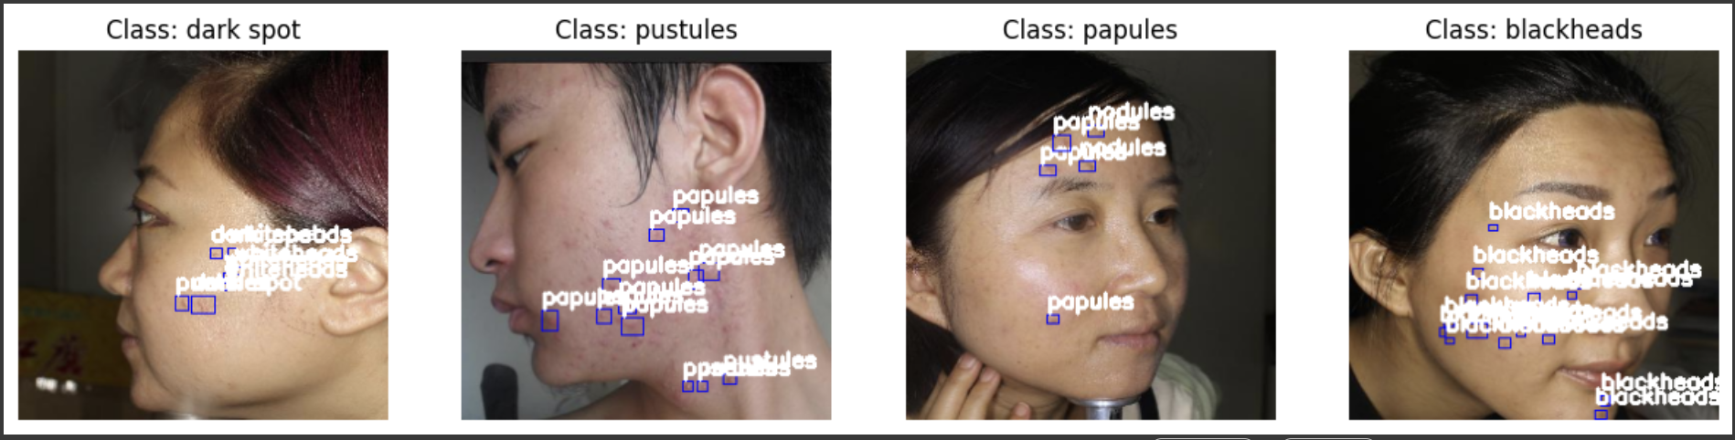
YOUR LOGO
HOME
ABOUT
SERVICE
CONTACT
IMPLEMENTATION
Data Preparation
Model Selection
Model Training
Evaluation
Post-processing
Deployment
Built With: Python, Javascript, HTML/CSS, OpenAI, OpenCV, Collab, Github, Yolov7,
Tensorflow, Scikit-learn
Notes:
https://docs.google.com/document/d/1VGeRp5CLudI8d9CkUfXYAtLNl8DXn09vwwZq_z2VKgU/edit?tab=t.0

Slide 5
DEMO

Slide 6
YOUR LOGO
HOME
ABOUT
SERVICE
CONTACT
QNA

